Slide 1
APGCE GeoHackathon 2024 Virtual Machine, Linux
Guidelines
Prepared by Najmi, Haslan, Norhayati
16.11.24
Open

Slide 2
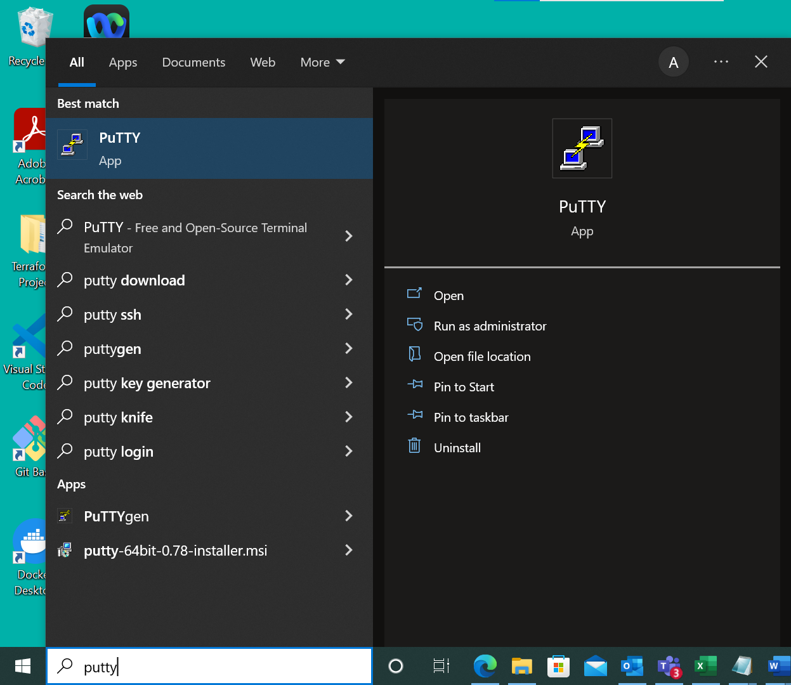
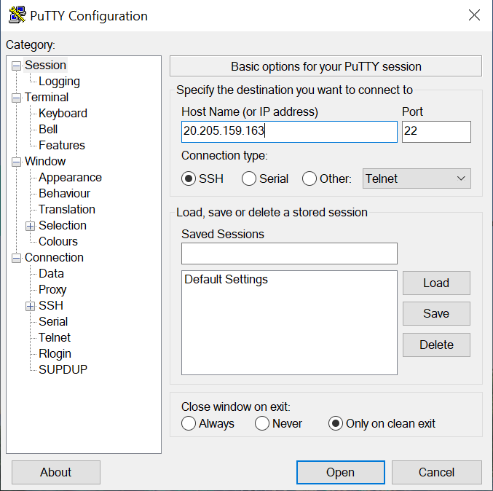
1
Select Start
Type putty on the search bar
Select PuTTY application
Enter the Public IP address
Click Open
3
2
3
4
4
5
2
1
5

Slide 3
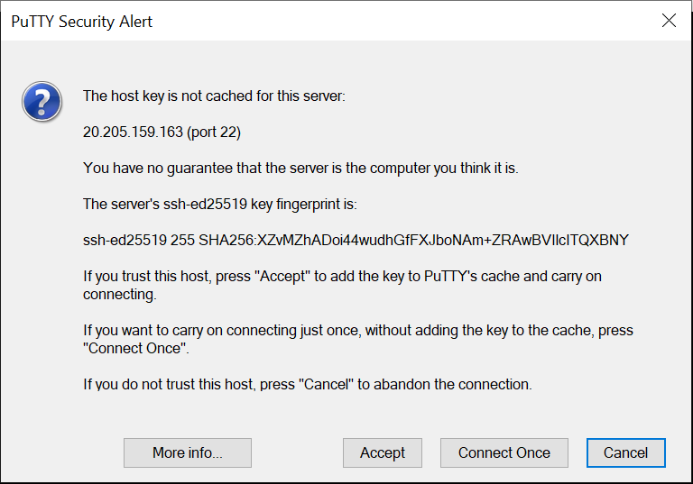
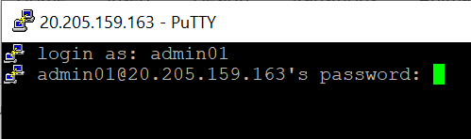
1
Select Accept
Enter username and password
Press enter to log in
2
2
NOTE:
For security reasons, the password will not be visible when you are typing. This is expected behavior.
3
3
1

Slide 4
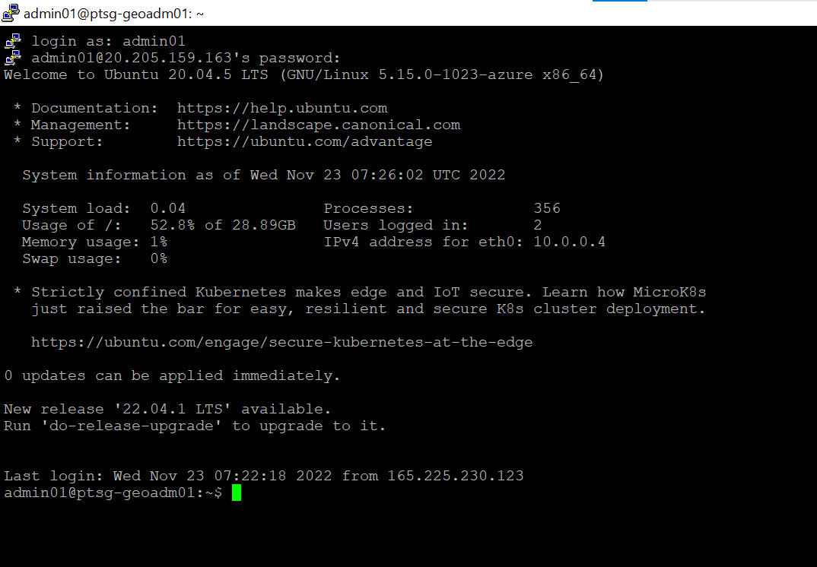
1
Virtual Machine will be launch
1

Slide 5
PETRONAS Passionate about Progress
Open

